Slide 1
Software Systems Design and Integration
Week 8
Java EE for the Web

Slide 2
Content
1 Java EE Technology Stack
  Application Architectures
  Software Infrastructure
  Development Framework
2 Java Servlets
  Servlet API
  Web Component Thread Model
  Handling Data and Session Management
  Servlet Development and Deployment
3 Java Server Pages
  JSP lifecycle
  Navigation
  Connecting to databases

Slide 3
Content (cont)
4 Using Java Beans as a data exchange mechanism in Java EE applications
  Using Java Beans on JSP pages
  Scopes of the beans
  Java Beans as data exchange mechanism on the Web

Slide 4
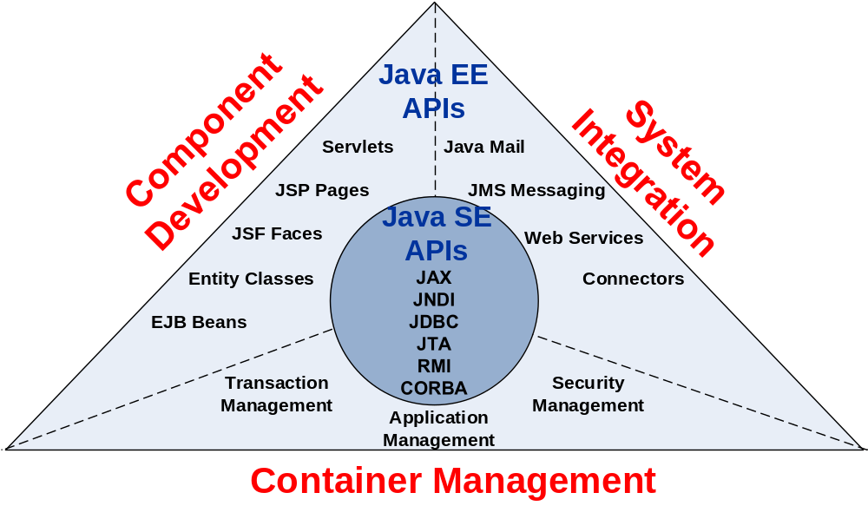
1 Java EE Technology Stack

Slide 5
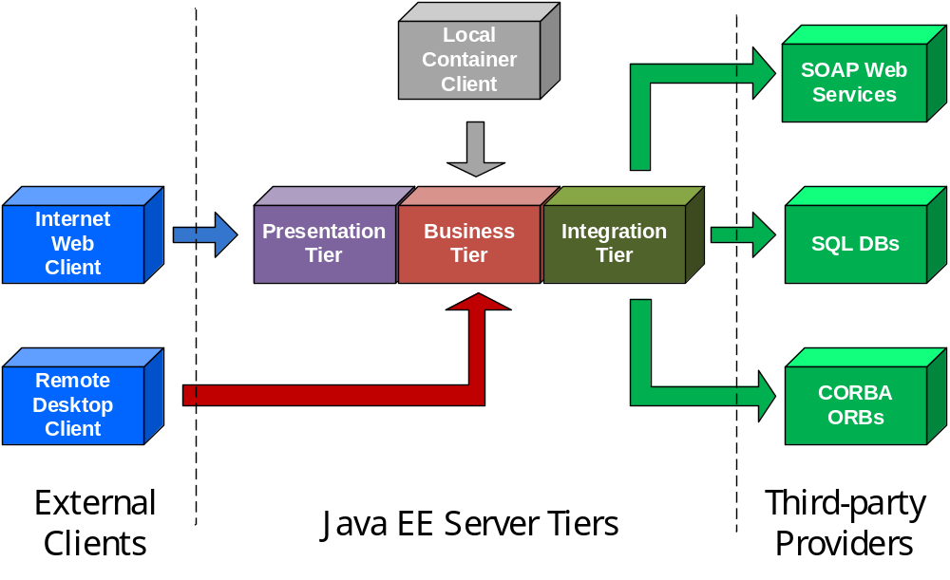
Multi-tier Architecture of Java EE Applications

Slide 6
Java EE Server-side Tiers
Presentation Tier: Servlets, JSPs, JSFs and Java Beans (Web Container)
Business Tier: EJBs and Entity Beans (EJB Container)
Integration Tier: JDBC, JCA, CORBA and SOAP (Web Container or EJB Container)

Slide 7
Java EE Software Infrastructure
  Server – off-the-shelf software, which supports Java EE applications execution and runs on multiple JREs on the server host
  Container – part of the Java EE server or the Java EE/Java SE client, which supports the component execution and runs on its own JRE
  Services – functionality, available in a container which supports component development, deployment and execution

Slide 8
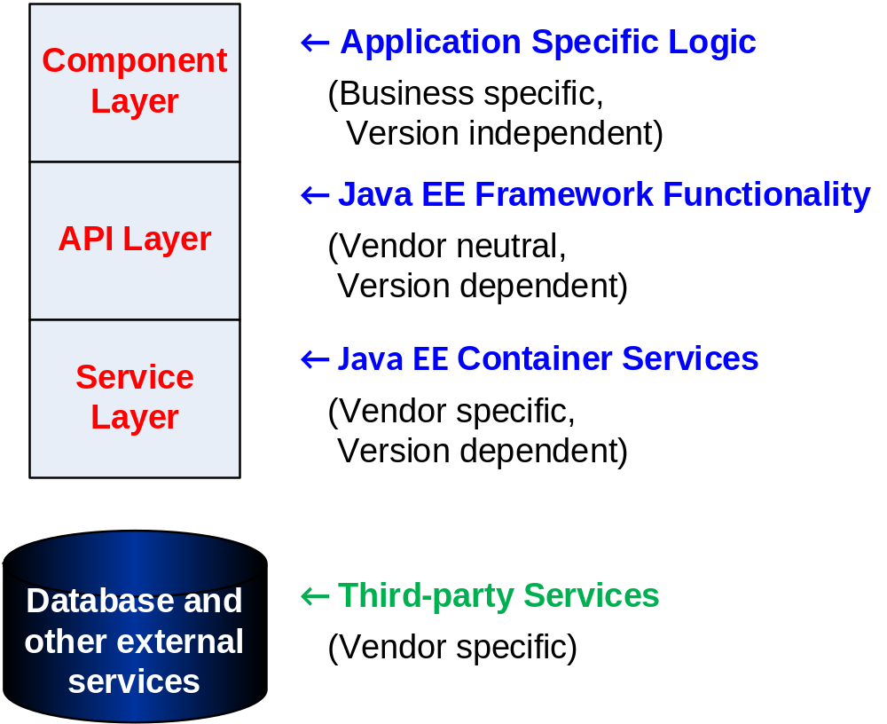
Java EE Component Model

Slide 9
Java EE Application Components
Servlets – Java classes, which can be executed on the server host within the Web server runtime environment
Java Server Pages (JSP) – HTML pages with special tags, which are compiled into servlets
Java Server Faces (JSF) – server-side templates which can be used to organise the interaction between servlets, JSPs and Entity Classes
Enterprise Java Beans (EJB) – Java classes which expose methods, available for remote calls from other components

Slide 10
Java EE APIs
Frontend APIs
Backend APIs
javax.servlet – servlets
javax.servlet.jsp – JSPs and JSTL tags
javax.faces – Java Server Faces
javax.jws – Web services
javax.websocket – Web socket communications
javax.persistence – OR mapping, databases, legacy systems
javax.annotation – access to container resources within components
javax.jmx – component deployment
Middleware APIs
javax.ejb – EJBs
javax.jms – JMS messaging, queues, and topics

Slide 11
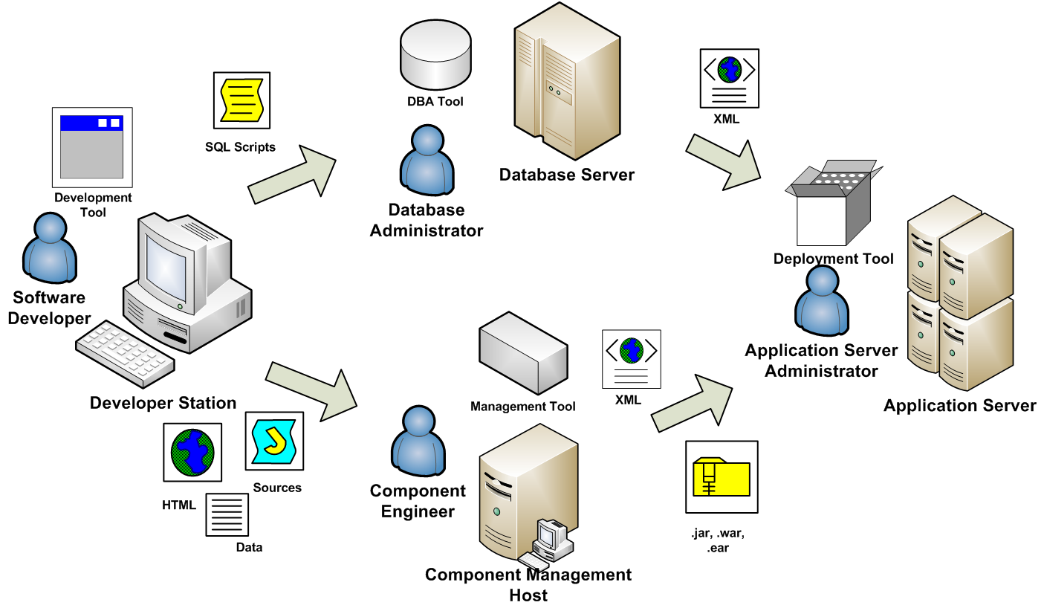
Typical Java EE Deployment Workflow

Slide 12
2 Java EE Web Components
Servlets – Java EE Components for the Web
  Request-response model (CGI)
  Form the Web tier of J2EE Framework
  Executed by the Web container of J2EE Servers (i.e., Glassfish, Jboss, WebLogic, IBM WebSphere, etc), Java Web servers (i.e. Tomcat), or additional modules of non-Java Web servers (i.e., Apache)
Java Web libraries
    javax.servlet
    javax.servlet.http
    javax.servlet.annotation (after Servlet 3.0)

Slide 13
Servlet API
  Java EE Servlet API includes a number of Java Interfaces, which are part of Java EE specification
  The Web developers use Java EE Servlet API to develop client/server Web applications through the server-side libraries, which come with the Java EE Web container, or compliant libraries, coming with the IDE
  The Web software engineers use the Java EE Servlet API compliant libraries which come with the Java EE Web container they are using to deploy the Java EE server/side components
  The end users run the Java EE Web applications through their Web browsers so they do not need these software libraries

Slide 14
Java Servlet APIs
Generic
Protocol-specific
Contain the most abstract classes and interfaces
Not specific to the protocol
Define core functionality of the servlets only
Extend the functionality of the generic servlets
Specific to the protocol in use (HTTP, FTP...)
Provide access to specific to the protocol classes (such as HTTPSession)
Vendor-specific
Contain classes implemented by the Java EE Web container
Allow using the Java Web container services
Available to the programmer

Slide 15
2.1 Servlet APIs
The servlet lifecycle control methods
  Specified by the Generic Servlet interface
  Implemented by the protocol-specific API and invoked automatically by the container
  Available to the programmer and can be invoked manually in the code
The request handling methods
  Specified by the Generic Servlet interface
  Implemented by the the protocol-specific API
  Overriden by the programmer
  Used by the programmer

Slide 16
Interface Servlet and the Servlet Life Cycle
Specifies the methods which have to be implemented by the programmer to let the container manage the servlets automatically
Servlet life cycle control methods
  Servlet container invokes the servlet’s init() method
  Servlet’s service() method handles requests
  Servlet’s destroy() method releases servlet resources when the servlet container terminates the servlet

Slide 17
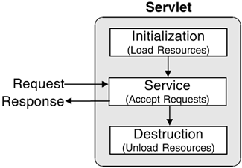
Servlet life cycle

Slide 18
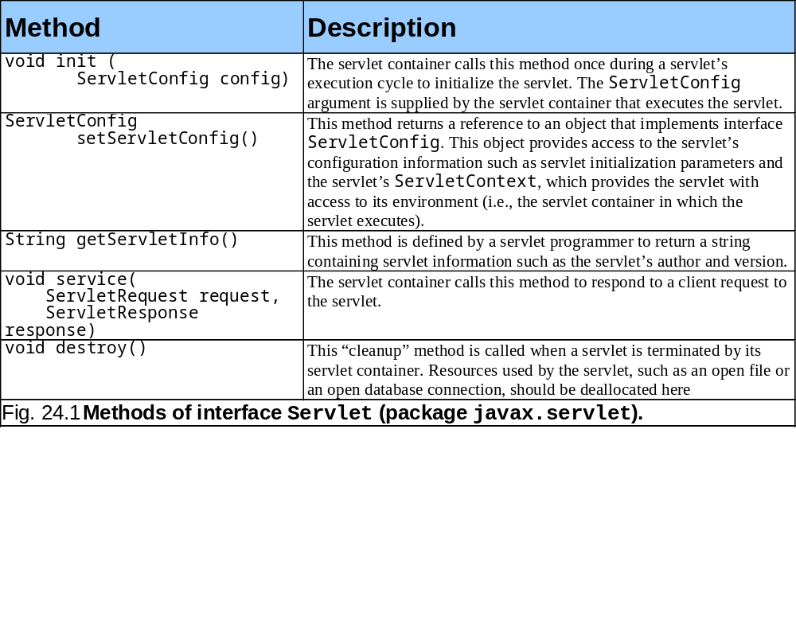
Servlet Life Cycle Methods

Slide 19
Class HttpServlet and request processing
Implements the Servlet Interface of Java EE Servlet API
  Overrides the method service of the servlet interface with an implementation which is specific to the HTTP protocol
  Provides default implementation for the lifecycle control methods of the servlet
  Has access to HttpServletRequest and HttpServletResponse objects as parameters

Slide 20
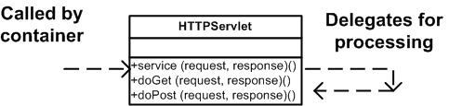
Request Handling
Based on the Delegate pattern for dispatching the request for further processing by specific HTTP request processing methods
Two most common HTTP request types
  Get requests are processed by method doGet
  Post requests are processed by method doPost

Slide 21
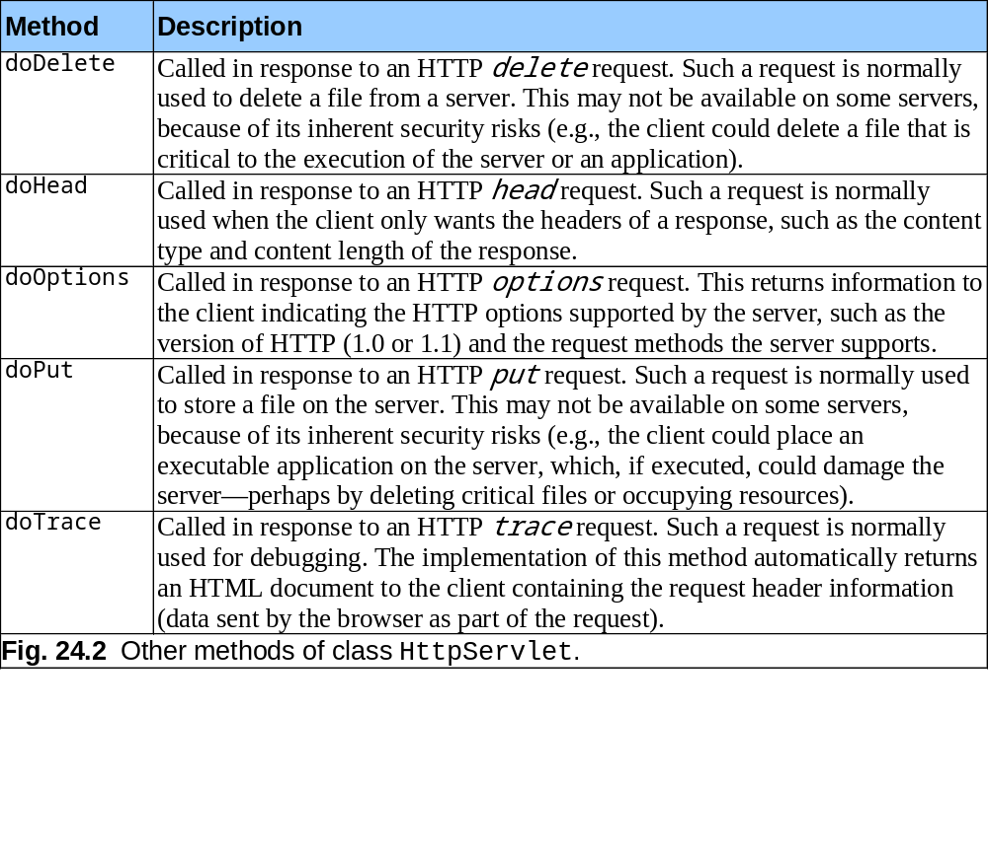
Request Processing Methods

Slide 22
HttpServletRequest Interface
Implemented by the Java EE Web container
Web server
  creates an HttpServletRequest object
  passes it to the servlet’s service method
HttpServletRequest object
  contains the request from the client
  service methods passes it to suitable processing method (delegation)

Slide 23
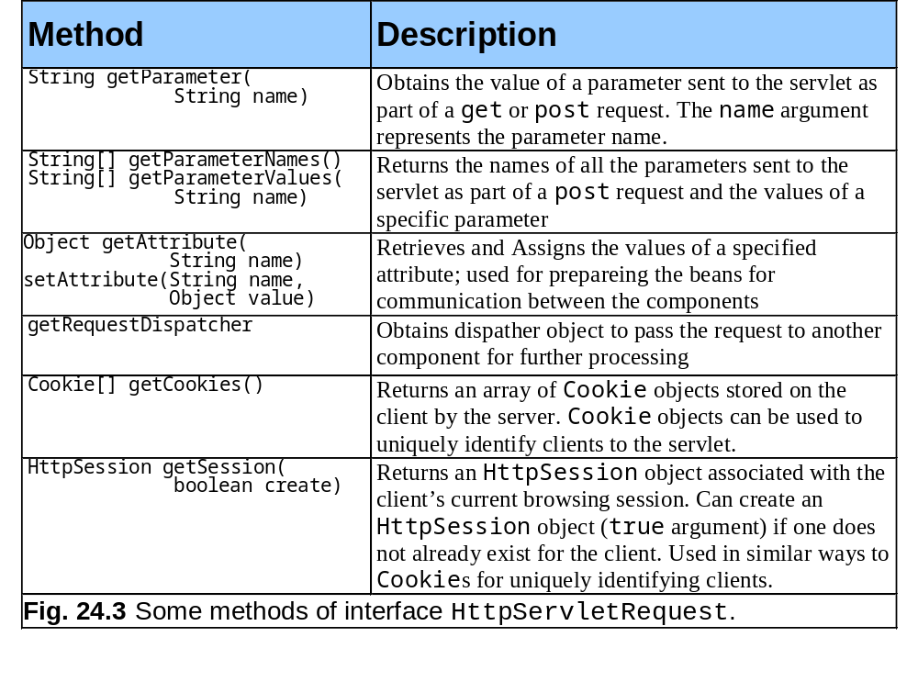
HttpServletRequest Methods

Slide 24
HttpServletResponse Interface
Implemented by the Java EE Web container
Web server
  creates an HttpServletResponse object
  passes it to the servlet’s service method
HttpServletResponse object
  Encapsulates the content of the response to the client (HTML, XML, text, binary, etc)
  Web server extracts the content from the object and sends it back to the client over the protocol in use (HTTP)

Slide 25
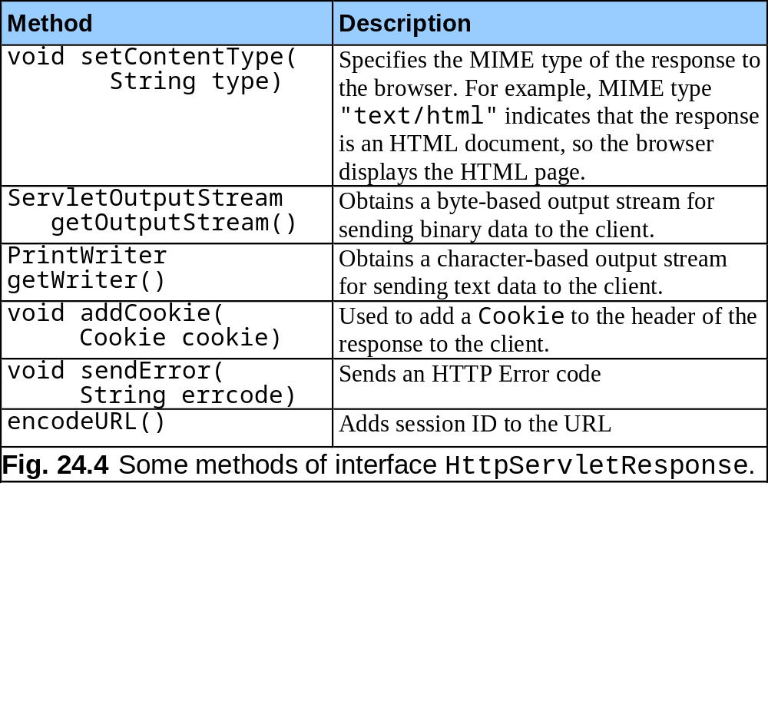
HttpServletResponse Methods

Slide 26
2.2 Web Component Thread Model
The Web container maintains pool of threads so each HTTP request is handled by a separate thread
The Web container runs a single instance of each servlet (unlike CGI where each program executes within a separate OS process)
The service method of the servlets may execute requests, belonging to different threads
Each of the request processing methods of the servlet runs within a thread; this may require additional thread synchronization

Slide 27
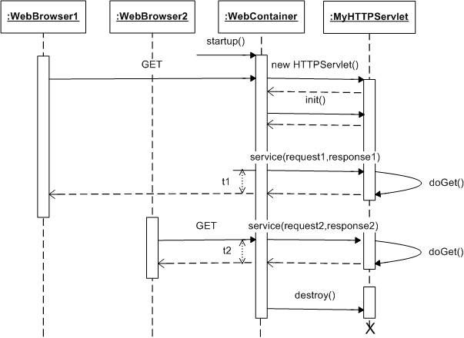
Sequence Diagram of Request Processing

Slide 28
Case 1: t2 starts after t1 finishes – no shared data, no need for event synchronization
Case 2: t2 starts after t1 starts and finishes before t1 finishes (later request but quicker response – may need thread synchronization depending on the operations)
Case 3: t2 starts after t1 starts but finishes after t1 finishes (later request, later response – may also need thread synchronization)
*** We cannot synchronize the lifecycle control methods of the servlets ***

Slide 29
Threads Synchronization
doGet(), doPost() etc. methods can process both method variables and class variables; only method variables should be used
The method variables can be static or dynamic; no static variables should be used
Critical sections of the code (i.e., access to shared resources, transactions) should be synchronized so that no more than one thread executes them at a time
  Synchronized (this) {
  // this section of the code can be
  // executed within one thread at a time
  ...
  }

Slide 30
2.3 Handling Data and Session
Management
Web data is part of the URL
http://www.mycom.com:8080/myapp/myservlet?par1=5
The physical connections are used for exchanging data between the client and the server
The communications can be synchronous (streamlined) or asynchronous (messaging)
  HTTP protocol is synchronous stateless request/response protocol which does not support state and sessions
  The synchronous communications for exchanging data require logical sessions
Web developers often need session control
  Java EE provides ways for implementing sessions

Slide 31
Processing HTTP Data
Immediate processing of the request end returning the result within the same component (end processing)
Initial processing of the request in one component and dispatching the request to for further processing by another component (forwarding)
  Internally to another component within the same application (Web servlet within the Web container or bean within the EJB container); in such a case the control will be returned back to the same component
  Externally to another URL; in such a case the processing will terminate after the dispatch

Slide 32
Example: End processing of the HTTP data
public void processRequest(HTTPRequest request,
HTTPResponse response)
throws IOException{
response.setContentType(“text/plain”);
PrintWriter out=response.getWriter();
String name=request.getParameter(“name”);
if (name == null || name.length() == 0)
name=“anonymous”);
out.println(“Hello, “ + name);
out.close();
}

Slide 33
Forwarding Control and Passing Data between Web Somponents
Obtaining the dispatcher from the container
RequestDispatcher dispatcher =
request.getRequestDispatcher(<relative URI>);
Obtaining the dispatcher from the deployment descriptor of the Web application
RequestDispatcher dispatcher =
getServletContext().
getRequestDispatcher(/<servlet nickname>);
Transfer the control to the target component
dispatcher.forward(request,response);

Slide 34
Example: transfer the control to another servlet and passing the data to it
Calling Servlet
Called Servlet
CustData custData =
new Customer(...);
request.setAttribute( “custData”,custData);
dispatcher.forward(
request,response);
CustData custData = (CustData)request.
getAttribute(“custData”);

Slide 35
Session Management API
HTTPSession Class – implemented by the container
HTTPSession Object – generated by the container each time a new session begins, has its own ID
<A HREF=‘showAcc;jsessionid=147JQ’>Show Acc>
setAttribute() and getAttribute() methods of the HTTPSession object can be used inside the servlet to manipulate the session information available to this servlet

Slide 36
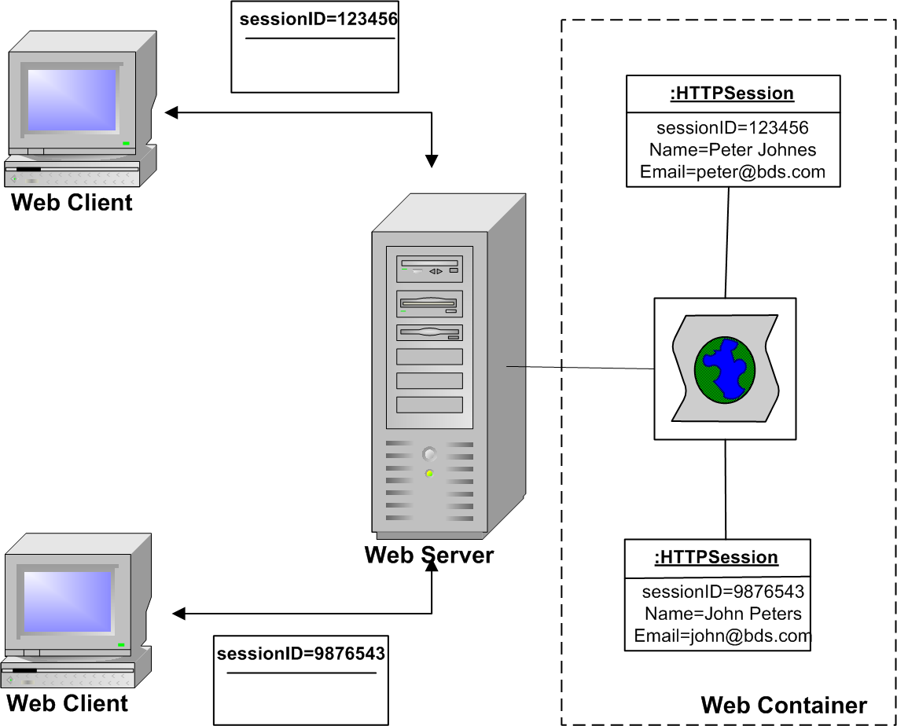
HTTP Sessions

Slide 37
Example: Session Rewriting for Identification and Authentication
Attaching info
to a session object
Extracting the info
from a session object
HTTPSession usrSession =
Request.getSession();
usrSession.
setAttribute(
“user”,(new User());
User usr = (User) session.getAttribute(“user”);

Slide 38
2.4 Servlet Development
  Part of Java EE Web Application, created by the programmer as extension of the standard HTTPServlet class
    Override the default methods of HTTPServlet class
    Possibly adds its own methods for data processing
  The code is a mix of information processing instructions (programmer describes), component lifecycle control (programmer prescribes, but container has default rules) and deployment instructions (programmer specifies but container decides)

Slide 39
Developing a servlet
  Importing the Java EE servlet API
    javax.servlet
    javax.servlet.http
    javax.servlet.annotation (post Servlet 3.0)
  Extending the class HTTPSevlet
  Servlet configuration
  Servlet initialization
  Writing servlet lifecycle methods
  Writing servlet data processing methods

Slide 40
An Example: ExampleServlet
package londonmet.web.example;
import javax.servlet.http.*;
import javax.servlet.annotation.*;
@WebServlet(“/Example”)
public class ExampleServlet extends HTTPServlet{
  @Override
  public void doGet(HTTPServletRequest request,
  HTTPServletResponse response){
  ...
  }
...
}

Slide 41
Servlet Configuration
  Using inline annotations (after servlet 3.0 in J2EE 6) or configuration descriptors (web.xml)
  Example: a servlet with a nickname
  @WebServlet(“/Nickname”)
  public class SomeHTTPServlet extends HTTPServlet{
  …
  }
  Example: a servlet with several nicknames
  @WebServlet(name=“SomeHTTPServlet”,
  urlPattrens={“/First”, “/Second”, …}

Slide 42
Servlet Initialization, Termination and Lifecycle control
Default behaviour – init() and destroy() methods
Additional user defined behaviour - before and after constructing, before and after destroying the servlet
Example: Additional processing after constructing
  public void init() {...}
  @PostConstruct public void myInitMethod() {...}
Example: Additional processing before destroying
  public void destroy() {...}
  @PreDestroy public void myDestroyMethod()
  {...}

Slide 43
2.5 Deploying the servlets
Deployed as part of Java EE Web applications
  Contain JSPs, servlets and their supporting files (organised in a separate folder with standard file structure according to the Web Application standard)
  Deployed to an application root folder on the Java EE server (require additional deployment descriptor)
  Executed by the Web container of the Java EE server using the JRE (need to be compiled)
Methods of deployment
  manually copying the files and writing the deployment descriptors
  in a batch mode using general-purpose utilities and deployment scripts (ant – operating system specific)
  interactively using special admin tools (server specific)
  in an automatic mode using file archives (.war, .jar, .ear)

Slide 44
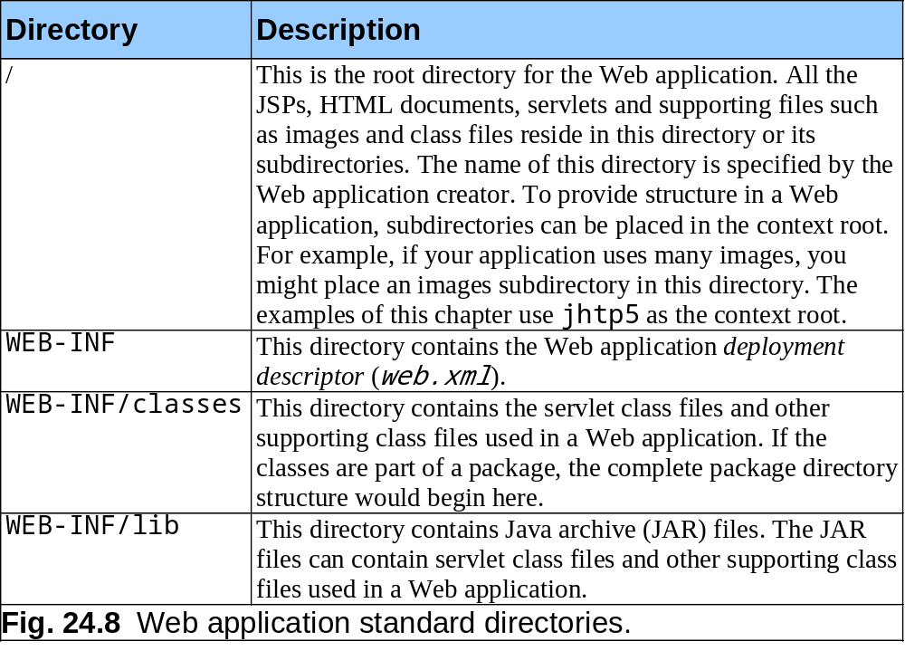
Java EE Web Application Structure

Slide 45
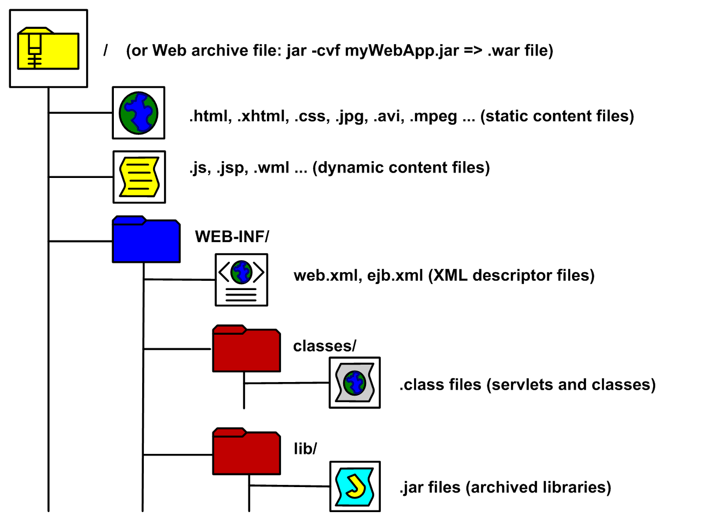
File structure of the deployment folder

Slide 46
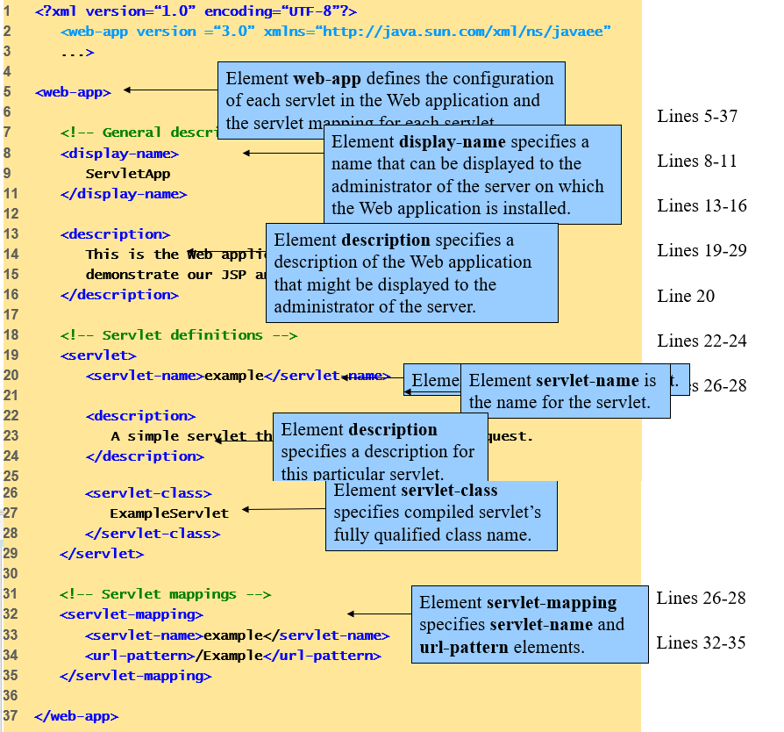
Deployment Descriptor web.xml

Slide 47
2.6 Running the Servlets
Invoking ExampleServlet using an URL
http://localhost:8080/ServletApp/Example
  - for testing on the local development server
  http://www.my.com/ServletApp/Example
- for accessing on the remote host after deployment
Elements of the URL
  Protocol (HTTP for Web applications)
  Host (localhost during deployement)
  Port (8080 for development, default 80 for the Web)
  Context (the root folder of the application)
  Nickname (as specified inline or in the web.xml file)

Slide 48
3 JSP as a presentation mechanism for Java EE Applications
JSPs are based entirely on Java servlets technology, hence implemented and executed by the Web container
  JSPs do not require full Java EE – compliant server, lightweight like Apache Tomcat is sufficient
JSPs separate static and dynamic content – the static is in HTML, the dynamic is in Java
  JSPs can be a front-end to any component from the enterprise architectures – Web, middleware or backend components
Additionally, JSPs provide a mechanism for extending the declarative style of Web integration with programming using tags and expressions

Slide 49
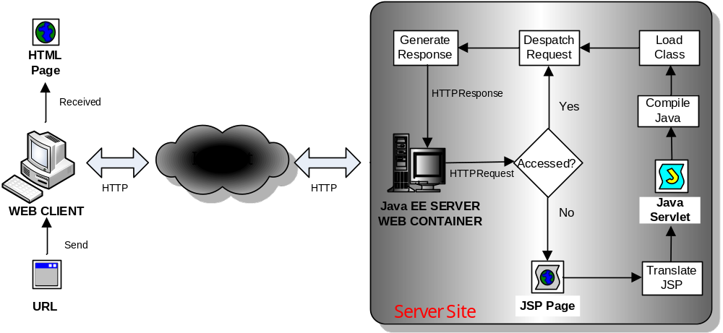
3.1 JSP Life Cycle

Slide 50
3.2 Elements of a JSP page
JSP Directives – passed to the Web container; remain transparent to the Web browser
HTML Tags – embedded as part of a servlet; form the static part of the Web content to be displayed
JSP Action Tags – translated using templates into Java code, which is embedded as part of a servlet compiled by the Java compiler and executed within the Web container by its Java SE engine
Java Scriplets – embedded directly as part of the Java code of the servlet
JSTL Tags – pre-processed by a Java utility which generate corresponding Java code to be incorporated into the Java code of the servlet

Slide 51
3.3 Navigation Control
<jsp:forward> action tag
  Specifies destination to another Web component
    Destination specified using an attribute
    Forwards the HTTPRequest object automatically
    Can forward requests only in the same Web application
  Corresponds to the forward(…) method, used by the dispatcher of the servlet
<jsp:param> action tag
  Specifies name/value pairs of information
    Name/Value pairs specified using attributes
    Stored in the HTTPRequest object associated with the page
  Not to be confused with the Java getParameter(…) method, which extracts a parameter of the URL

Slide 52
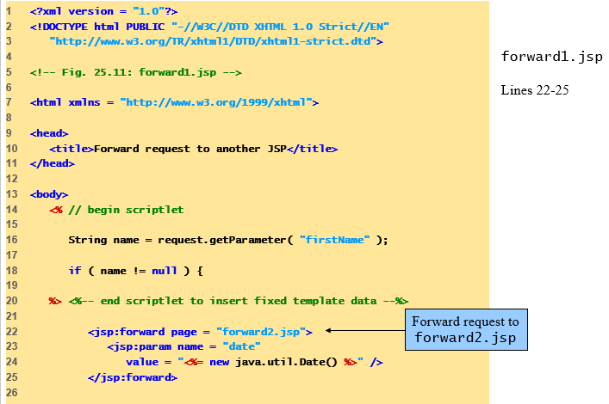

Slide 53
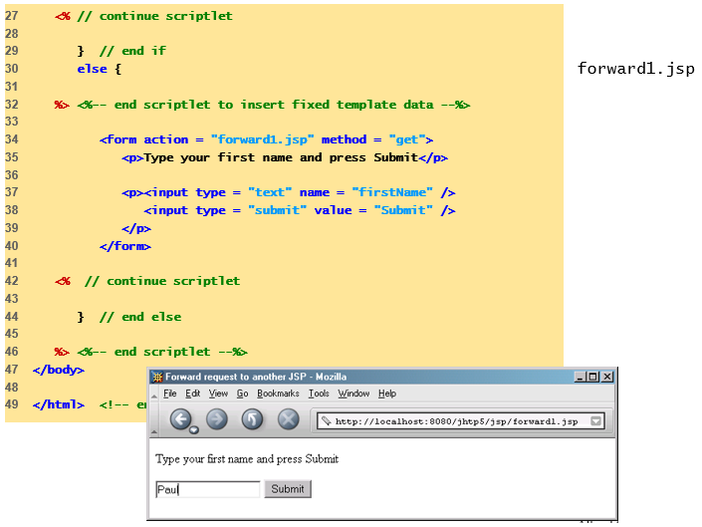

Slide 54
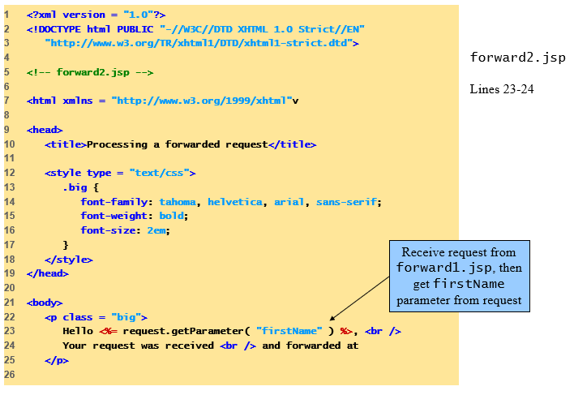

Slide 55
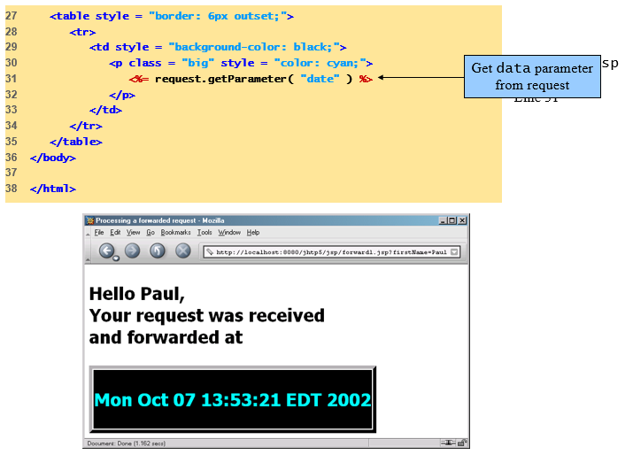

Slide 56
3.4 Connecting to databases from JSP pages
The use of database connections on JSP pages must be limited for design considerations
There are alternatives to use DB data in JSPs
  include Java scriplets to deal with the database using Java SE (not recommended for design reasons)
  use dedicated Java beans to connect to the database (possible if the database information is used only in the Web tier, for example for data validation, generating drop-down menus on the Web pages, etc.)
  use JSTL custom tags (recommended if there is only a Web container in the application)
  Use separate EJB beans especially for DB connection (preferred when using both Web and EJB containers)

Slide 57
3.5 Extending JSPs using Library and Custom Tags
Allow Web designers to use the functionality supported by the tags in exactly the same way as they use HTML tags, without any programming
  Implemented using separate Java classes for each tag
  XML style of specification of the operations rather than Java style of method invocation
JSTL is a standard tag library which encapsulates some core functionality
  Experienced Web developers can develop their own tag libraries for specific data processing in their domain
Both JSTL and custom tag libraries must be defined on a JSP page prior to their use by the JSP directive taglib

Slide 58
Using taglib JSP directive to enable custom tags on JSP pages
Specification of the tag library
<% @taglib uri=“<tags definition>” prefix=“do” %>
Information passed to the container
  New JSP tag prefix which can be used (i.e., do)
  The set of new JSP tags to be used with this prefix is defined in the iterator-tags.tld file (i.e, iterate)
Use of the tags in JSP
<do:iterate>
...
</do:iterate>
Can be used to instruct the container to apply an operation for processing collection data structure which implements the java.util.Iterator inteface

Slide 59
Using tag-library XML descriptor for loading the tag library into the container
An xml tag to define library file to be loaded by the container (in the web.xml file of the Web app)
Defines a new prefix for JSP tags to be used when the JSP is translated into servlets
Specifies library file to be loaded by the container
Example: Definition of the iterator tag
<jsp-config>
<taglib>
<taglib-uri>http://myServer.com/myApp
</taglib-uri>
<taglib-location>/WEB-INF/tld/mytags.tld
</taglib-location>
</taglib>
...

Slide 60
Using tag XML descriptor to specify the implementation of the tags
An xml file with extension .tld
Specifies the mapping between JSP tags and Java classes to be used during translating the JSP pages into Java servlets
Example: Implementation of the iterator tag
<tag>
<name>do</name>
<tagclass>com.my.taglib.doTag</tagclass>
<attribute>
<name>id</name>
<required>true</true>
</attribute>
</tag>

Slide 61
Adding Expressions to JSP Tags using Expression Language (EL)
Simple object-oriented language for calculating expressions through combining attribute values using logical and numerical operations
Based on ECMAScript and close to JavaScript
Example 1: Calculating numerical expression
${3+2}
Example 2: Referring to an object attribute
${cust.name}
Example 3: Checking logical condition
${not empty currentSession.user}

Slide 62
Example: Using tag libraries in JSP
<%@taglib uri=“http://java.sun.com/jsp/jstl/core
prefix=“control”%>
<control:forEach var=“currency”
items=“${request.currencies}”>
<tr><td>${item.currency}:</td>
<td>${item.amount}</td></tr>
</control:forEach>
...
<control:choose>
<control:when test = ${request.password == null}>
...
</control:when>
<control:otherwise>
...
</control:otherwise>
</control:choose>

Slide 63
4 Java Beans as a Data Exchange Mechanism for Java EE Applications
Java beans is a convenient mechanism for temporary data storage and transportation between components
The beans encapsulate data in private attributes, i.e. double Interest, but expose APIs consisting of methods without parameters
  The names of those methods are composite, consisting of the prefix “get” (for accessor) or “set” (for mutator) and the name of an attribute - i.e, getInterest()
The beans are ordinary Java classes with a constructor without parameters
  They can be instantiated manually, through their constructor (programmatic beans), or automatically, by other programs using a separate bean factory (managed beans)

Slide 64
4.1 Using Java Beans on JSP pages
The managed beans are instantiated automatically by the Java EE containers whenever required using the bean factory of the container
The specific data operations can be performed by invocation of suitable accessor/mutator methods, which can be mapped automatically by the container thanks to the naming convention adopted
In order to be able to use beans on the JSPs the Web developers must instruct the container to make the bean factory visible by declaration

Slide 65
<jsp:useBean> Action Tag in JSP
  The execution of the tag creates new instance of the bean class, or locates an existing bean in the Web container
  This allows the container to manipulate explicitly Java objects (defined by the developer) using suitable JSP tags on the page
    Requires the bean definition to be visible in the context of the page so that it can be imported during the translation of the JSP page into a servlet
    The beans must be compiled before loading the JSP page into the container so that they can be linked to the code of the servlet at the compilation phase (during the initial load of the page)

Slide 66
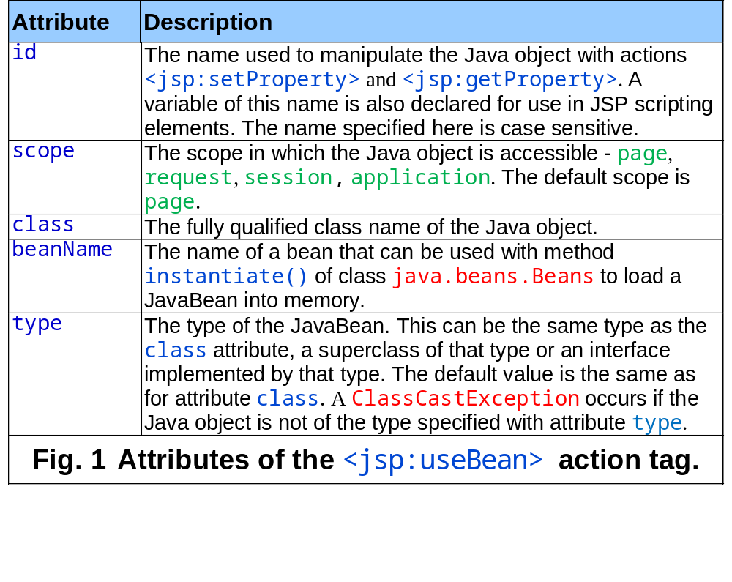

Slide 67
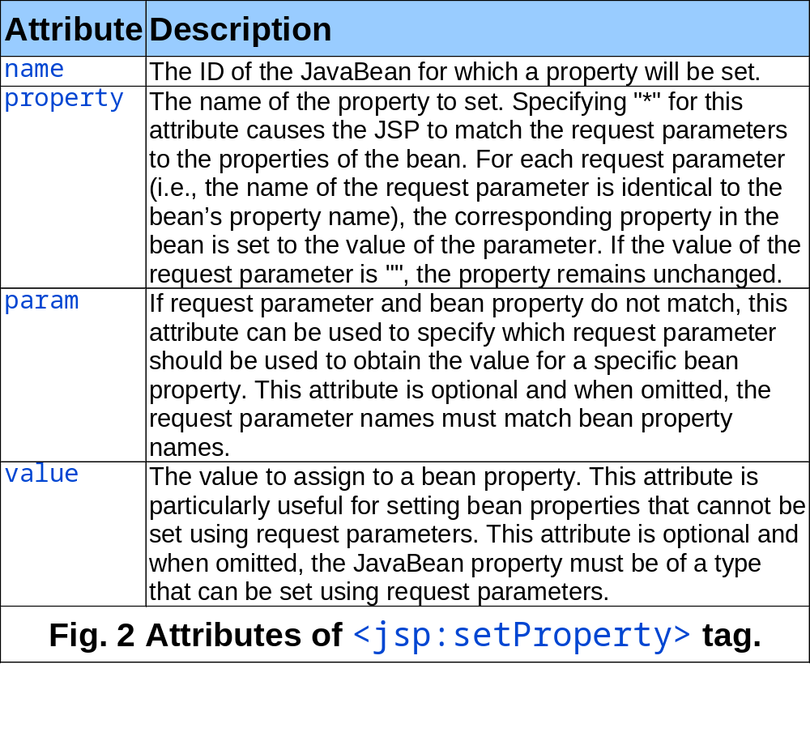

Slide 68
4.2 Scopes of Java Beans
  The bean objects are created when the first page which uses them is loaded into the memory
    The bean classes are instantiated by the container automatically using the bean factory
  The beans have scope of existence, determined by the scope attribute of the useBean tag – application, page, session and request scope
    Depending on the bean scope, the object references to the bean and all object references used by the bean itself are stored in different contexts
  The beans are reclaimed by the container when the context object is released from the memory

Slide 69
Java Beans in different scope
 | Application | Session | Request | Page
Context object | ServletContext | HTTPSession | HTTPRequest | PageContext
Access from | all components from the same application | only components available in the same Web session | components processing the same Web request | components used on the same Web page
Specific use | app-specific (database connections, data files, parameter initializations) | session- specific (users and passwords, sessions and transactions) | request-specific (local data, timers, counters) | page-specific (display data, navigation controls)

Slide 70
4.3 Java Beans as a data exchange mechanism for Java EE components
  When the beans are defined within the scope of a container, they exist as Java objects within this container and can be used by any components in it
  But the beans can be also accessed from any Java EE components with access to the container (i.e., from other beans, servlets, classes, JSPs, EJBs…)
  So the beans can be used to transport data within a single layer and/or between any two layers of the enterprise architecture:
    presentation layer and business logics layer
    business logics and business data layer
    presentation layer and business data layer
    business logics and business data layer

Slide 71
Using Java Beans for collecting data from servlets
Servlet processes the request using the HTTPRequest object
Servlet sets an attribute of the request object to pass data to the JSP page
Servlet uses the RequestDispatcher control object to navigate to a JSP page
The JSP page uses useBean tag with request scope attribute to collect the data from the servlet
The JSP presents the data in HTML format using suitable formatting

Slide 72
Example: Transporting customer data from a servlet to a JSP page using Java bean
public void doPost (HTTPRequest in, HTTPReponse out){
String firstName, lastname; // method scope data
...
try {
Customer c = new Customer(firstName,lastName);
in.setAttribute(“customer”, c); // request scope data
...
RequestDispatcher d =
getServletContext().
getRequestDispatcher(“showCust.jsp”);
d.forward(request, response); // navigation to JSP
} catch(Exception e) {
...
} // end catch
} // end method

Slide 73
(cont) Transporting customer data from a servlet to a JSP page using Java bean
<jsp:useBean id=“customer”
class=“com.myApp.Customer”
scope=“request”/>
...
<b> And your customer is: </b>
<jsp:getProperty name=“customer”
property=“firstName”/>
<jsp:getProperty name=“customer”
property=“firstName”/>
...

Slide 74
Using Java Beans for presenting data from databases
Servlet or a JSP page processes the request using the HTTPRequest object
A JSP page uses useBean tag with application scope attribute to collect data from the backend for presenting it on the Web
The bean extracts the data from the database using standard JDBC connection
The JSP page incorporates the data in the HTML response using suitable formatting

Slide 75
Example: Using Java Beans to connect to Databases from JSP
JSP Page: adrotator.jsp – shows an image of the cover of a Deitel book and navigates to the Amazon page for it; the navigations occurs when clicking on the image of the book
Java Bean: rotator.java – provides images and URL for selected book from the collection of books, represented internally as a pair of String arrays; the selected book is determined by the current value of the array index
External references inside the JSP page: the picture files and the URLs for the corresponding Deitel books on www.amazon.com

Slide 76
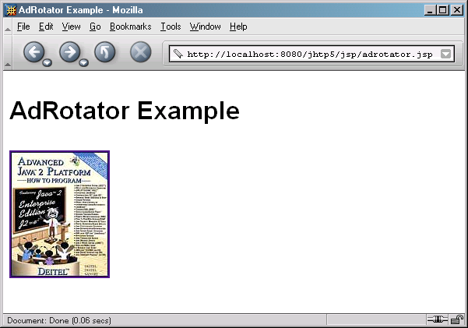
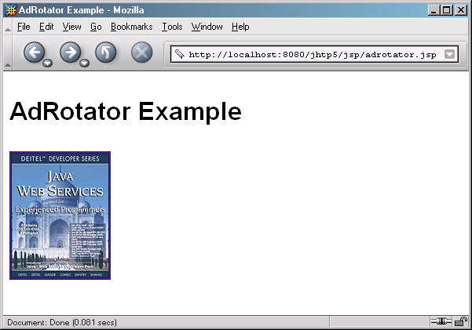

Slide 77
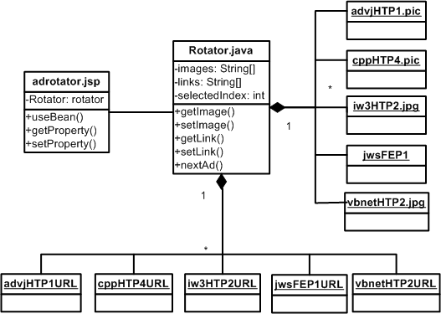
Rotator Class Diagram

Slide 78
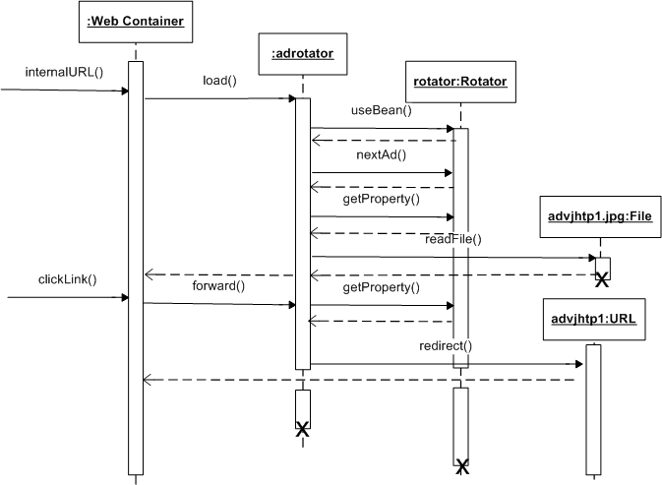
Rotator Sequence Diagram

Slide 79
Summary: Comparison between JSPs and servlets in the presentation layer
Characteristics | Servlets | JSPs
Web content generation | Uses println() method to generate HTML | Specifies the HTML tags directly
Navigation | Similar, but with different syntax
Implicit objects | Identical (request, response, session, context)
DB access | Using JDBC only | Using JDBC, Java beans and JSTL tags
Invocation | Identical (CGI standard, via URL)
Loading | Loaded into the Web container | Extra translation and compilation steps
Execution | Identical, both with support for multi-threading
Testing | Difficult to test visual content (recompilation) | Easier to test (no recompilation)
Debugging | Easier to debug (tracing using the IDE) | Difficult to debug (extra printout for tracing)

